Slide 1

Customer Churn Predictions using ml
Les clairvoyants
14.11.2022

Slide 2





Meet the team
RITA STARZYK
CHADI GHOSN
YEVGENIY DENKOVYCH
KIRRAN KAYANI

Slide 3

Agenda
INTRODUCTION
PROJECT DIAGRAM
ETL PROCESS
TABLEAU
INSIGHTS & OBSERVATIONS
ML MODELS
AI SELENIUM CODE

Slide 4

INTRODUCTION
WHAT & WHY
We are a team of machine learning engineers and we’ve won a bid with “Telco” to create a machine learning model that will predict customer churn.
Customer churn prediction is an emerging phenomenon that enables companies to take the necessary steps to retain clients thus retaining constant revenue.

Slide 5
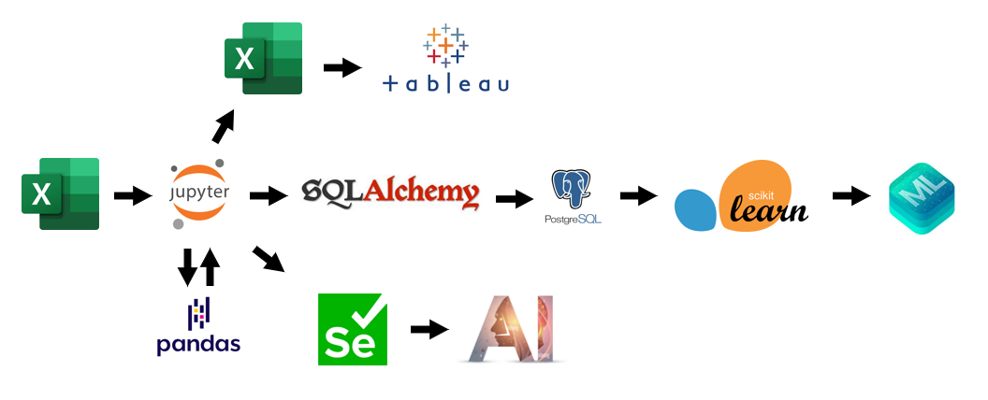
Project diagram

Slide 6

ETL PROCESS
Let’s Dive In

Slide 7
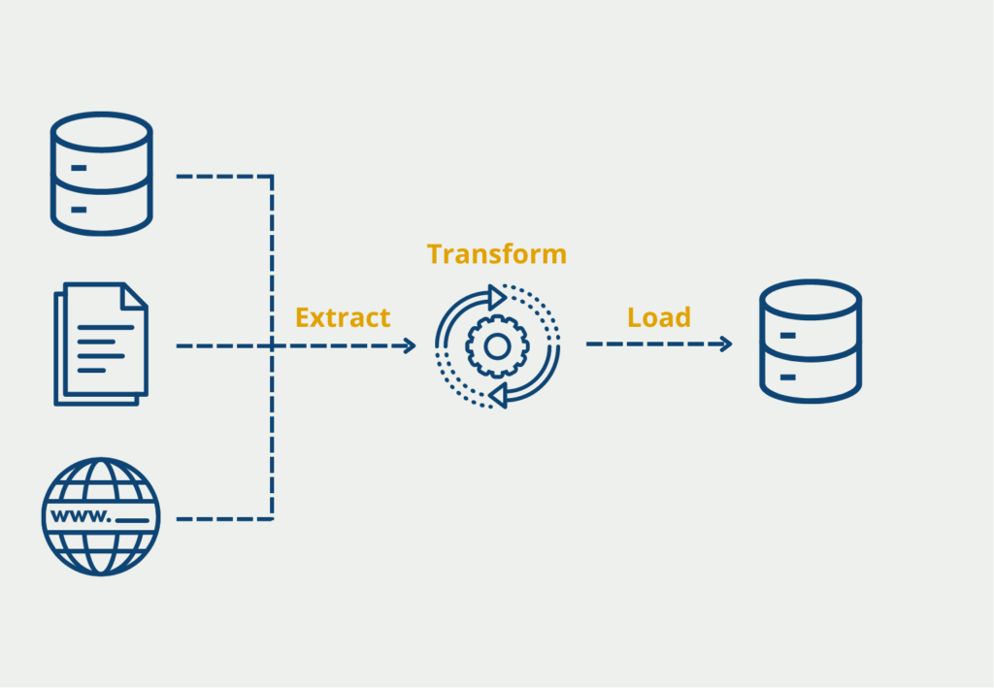
Import needed libraries
Ingest csv files from source (Kaggle) and appended them together
Checking for null values and data types for every column
Mapped “Churn” column to change yes to 1 and no to 0
Dropped the “State” & “area code” columns (irrelevant)
Check number of unique values (checking categories)
Convert categorical data to numeric for ML usage
Checking for null values and data types for every column
Push data to csv (use in Tableau) and to PostgreSQL (use in ML models)
ETL Steps:

Slide 8

TABLEAU
DASHBOARD PRESENTATION

Slide 9
INSIGHTS & OBSERVATIONS
Let’s Dive In

Slide 10

Based on the tableau dashboard, we can deduce the following:
There is no positive or negative correlation between the total number of minutes and the account lengths.
Between 2012 and 2014:
The company registered the highest number of customers.
These customers made the highest numbers of calls until 2020, and also the highest number of calls to customer service.
The number of customers who churned was also highest between mentioned years.
The churn rate remained relatively stable for these customers (avg. 14%), thus:
no relationship between the number of months the customer has stayed with the company and the churn rate.

Slide 11
ML MODELS
Model scores and performance

Slide 12
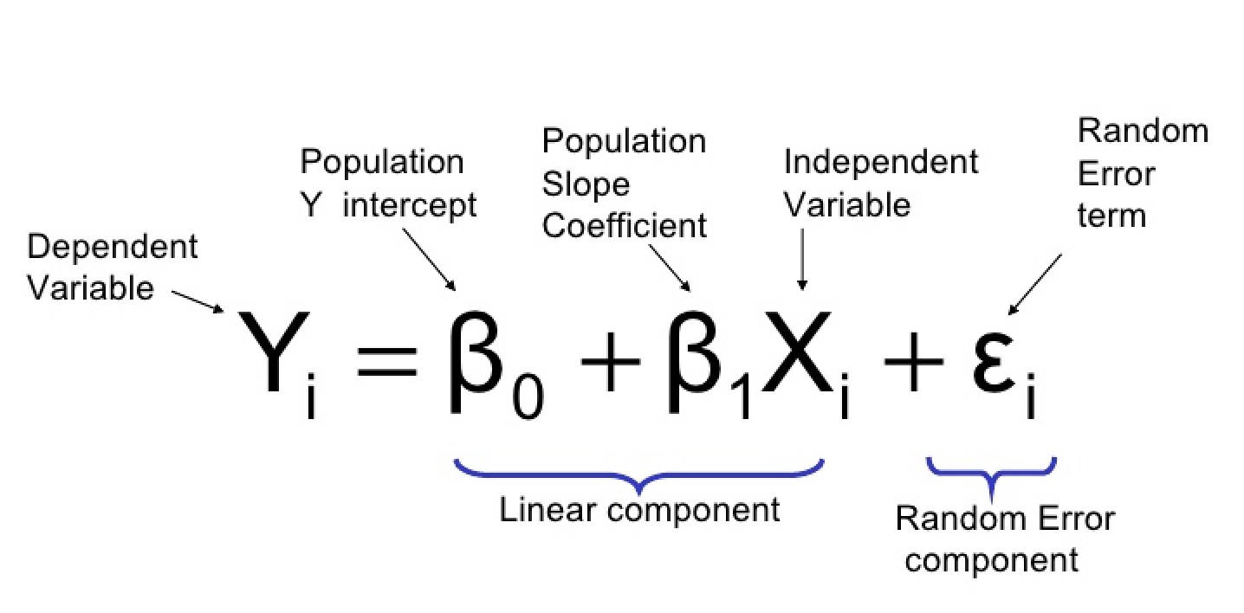
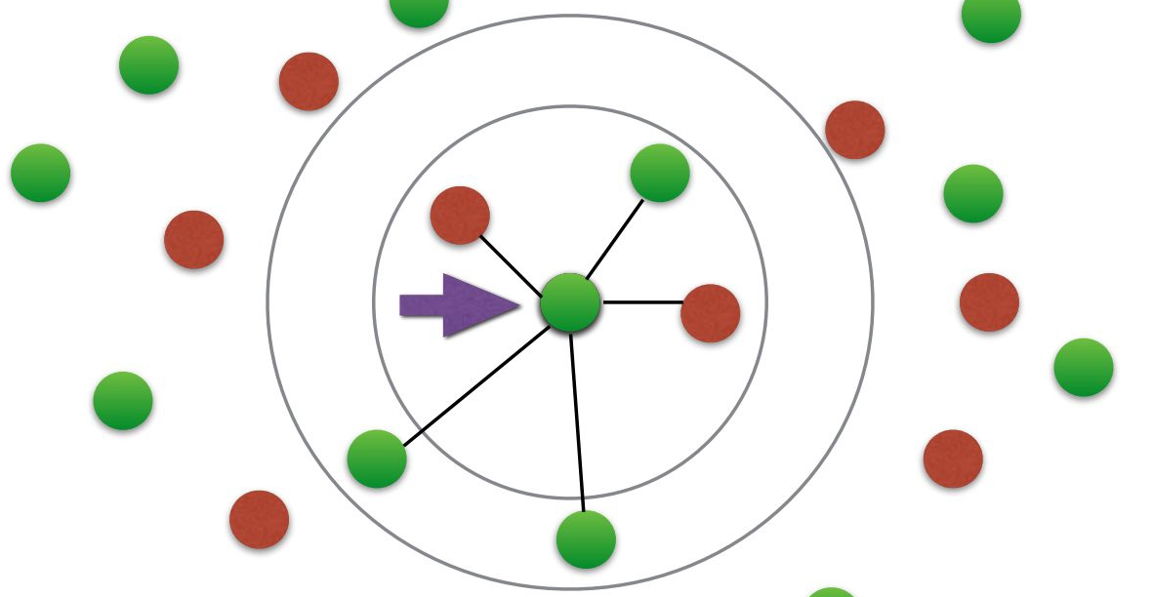

Model 1: Logistic Regression
Train model score: 83.25%
Test model score: 81.28%
Accuracy: 77%
TP: 137
TN: 823
FP: 190
FN: 100
Model 2: KNN
K = 9
Train model score: 86.7%
Test model score: 83.9%
Accuracy: 83%
TP: 122
TN: 913
FP: 100
FN: 115
Model 3: RFC
Train model score: 95%
Test model score: 88%
Accuracy: 84%
TP: 146
TN: 905
FP: 146
FN: 91

Slide 13
AI SELENIUM CODE
EXTERNAL AI WEBSITE

Slide 14
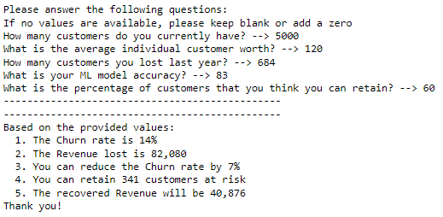
AI Model
The below code is connected to an AI model website, it will ask a series of questions, and generate answers accordingly:

Slide 15
ANY QUESTIONS?
THANK YOU

